Slide 1
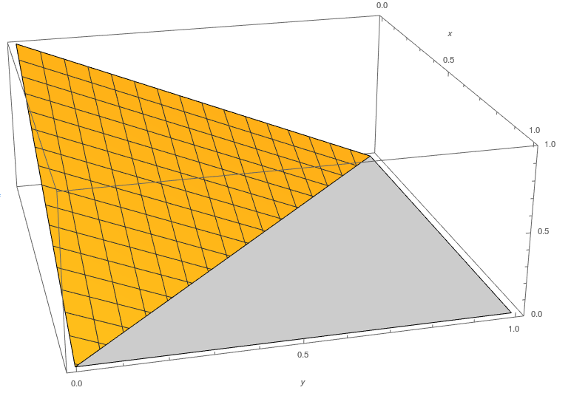
Data Generation Specifics
Jiahuang Lin

Slide 2
Data Generation
Data is generated with a Python script
Input:
n, the number of individuals
K, the number of isoforms
maf, the minor allele frequency
Output:
Isoform proportion of each individual
Generate genotype data for each individual
Generate values for noise + intercept + effect
Generate Dirichlet pdf parameter using intercept, noise, effect and genotype
Generate isoform proportions for each individual using Dirichlet pdf parameter

Slide 3
Data Generation: Step 1
Given n (number of individuals), perform 2n Binomial draws, each with probability=maf.
Example output: []
Generate genotype data for each individual
Generate values for noise + intercept + effect
Generate Dirichlet pdf parameter using intercept, noise, effect and genotype
Generate isoform proportions for each individual using Dirichlet pdf parameter

Slide 4
Data Generation: Step 2
Draw noise and effect from normal distribution.
Draw intercept from uniform distribution from [-1, 1]
Generate genotype data for each individual
Generate values for noise + intercept + effect
Generate Dirichlet pdf parameter using intercept, noise, effect and genotype
Generate isoform proportions for each individual using Dirichlet pdf parameter
Background
Theoretical model
Implementation
Result

Slide 5
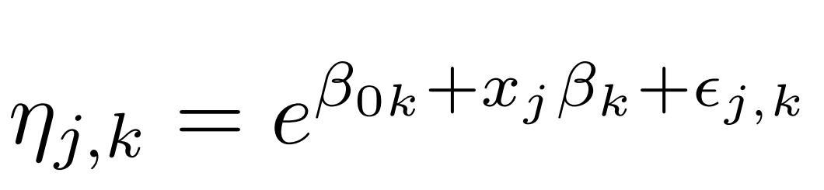
Data Generation: Step 3
Generate genotype data for each individual
Generate values for noise + intercept + effect
Generate Dirichlet pdf parameter using intercept, noise, effect and genotype
Generate isoform proportions for each individual using Dirichlet pdf parameter

Slide 6
Data Generation: Step 4
Draw isoform proportions from Dirichlet pdf.
Generate genotype data for each individual
Generate values for noise + intercept + effect
Generate Dirichlet pdf parameter using intercept, noise, effect and genotype
Generate isoform proportions for each individual using Dirichlet pdf parameter

Slide 7
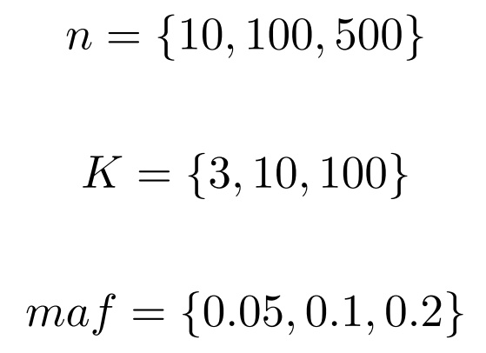
Data Generation
Parameters varied:
27 folders created, each containing:
500 files for simulated data
500 files for permutations of simulated data
1 file for results

Slide 8
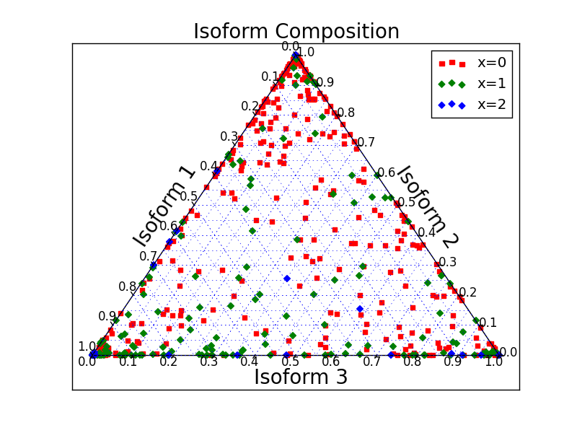
Plots of Data Generated
n = 500
maf = 0.1

Slide 9
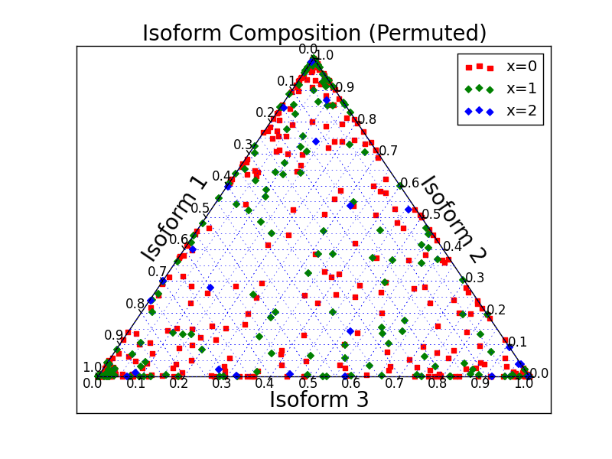
Plots of Data Generated
n = 500
maf = 0.1

Slide 10
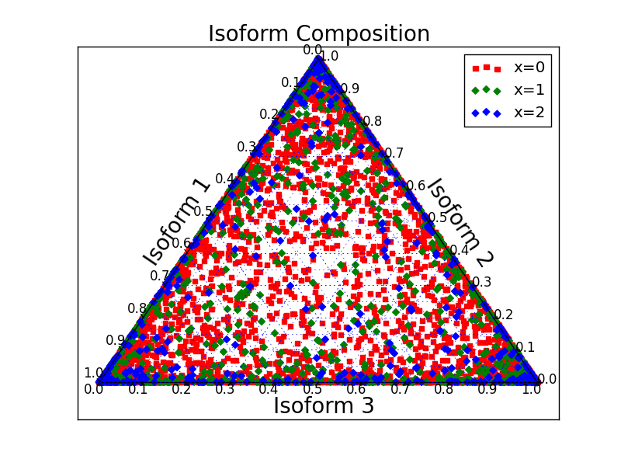
Plots of Data Generated
n = 10
maf = 0.1

Slide 11
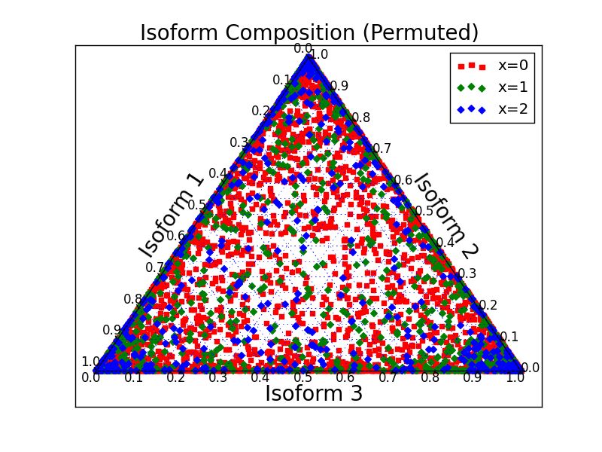
Plots of Data Generated
n = 10
maf = 0.1

Slide 12
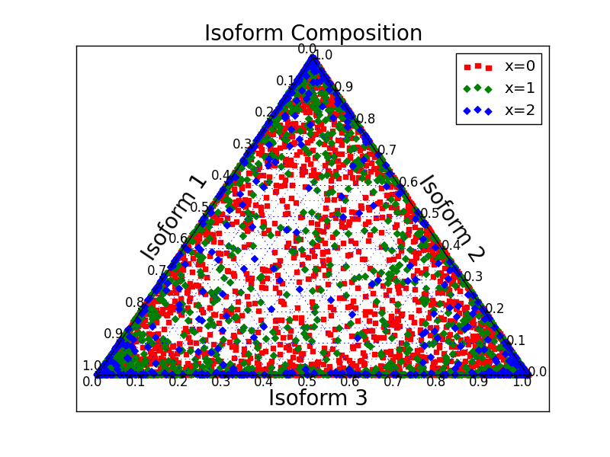
Plots of Data Generated
n = 10
maf = 0.2

Slide 13
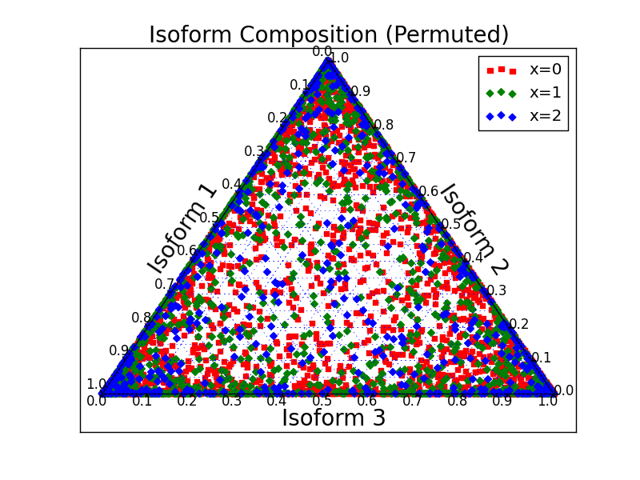
Plots of Data Generated
n = 10
maf = 0.2

Slide 14




Implemented Alternative Method
Computed Pseudo F-Ratio (All theoretical results come from “A new method for non-parametric multivariate analysis of variance” by Anderson)

Slide 15

Precision Recall Curve
$P= \frac{T_{p}}{T_{p}+F_{p}}$
$R= \frac{T_{p}}{T_{p}+F_{n}}$
For each threshold p-value, calculate the Precision and Recall value of all the 1000 files.

Slide 16
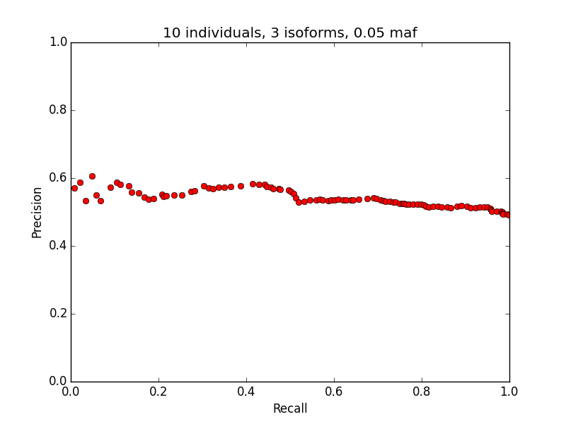
Precision-Recall curve

Slide 17
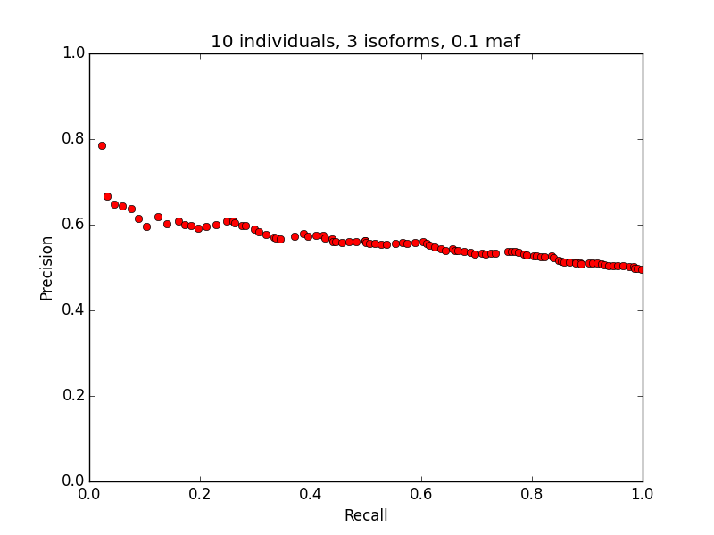
Precision-Recall curve

Slide 18
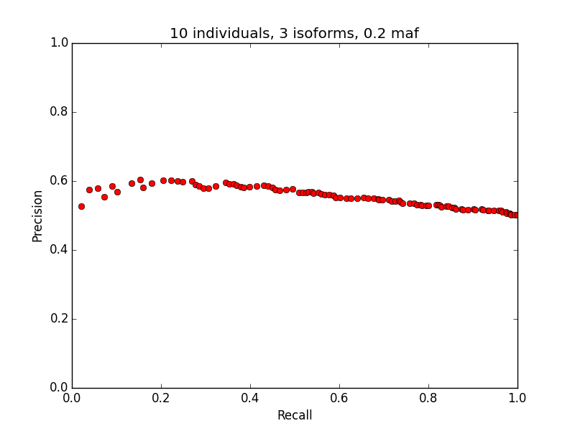
Precision-Recall curve

Slide 19
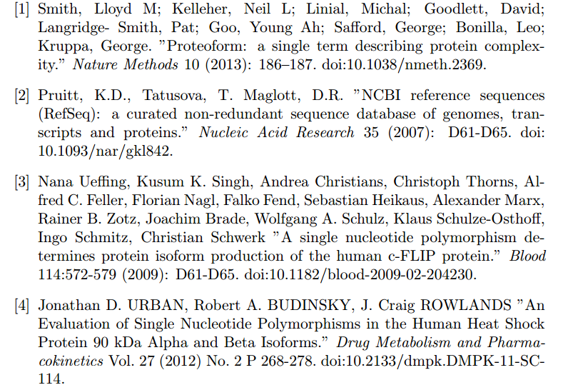
Acknowledgements

Slide 20
[5] Anderson, Marti J. "A New Method for Non-parametric Multivariate Analysis of Variance." Austral Ecology 26, no. 1 (2008): 32-46. doi:10.1111/j.1442-9993.2001.tb00081.x.
[6] Monlong, Jean, Miquel Calvo, Pedro G. Ferreira, and Roderic Guigó. "Identification of Genetic Variants Associated with Alternative Splicing Using SQTLseekeR." Nature Communications Nat Comms 5 (2014): 4698. doi:10.1038/ncomms5698.

